Slide 1

THE CHRONIC KIDNEY DISEASE
(CKD) PATIENT MANAGEMENT SYSTEM
Database-driven healthcare platform for patient records, laboratory data, appointments and CKD prediction
PROJECT PRESENTATION
Team 06
ROLL NUMBER
TEAM MEMBER
2520080060
J. Sohan
2520090137
J. Sri charan
2520080036
Adithya vishnubatala
25CS1302E • Y25–2026–2027 • Trimester 4

Slide 2
Abstract
02
PROJECT OVERVIEW
What the system does
Expected outcome
• Centralizes patient, doctor, laboratory, appointment and CKD prediction records.
• Uses PostgreSQL for structured relational data and MongoDB for flexible clinical documents.
• Provides a FastAPI backend with validation, authentication and role-based access.
• Supports a CKD classification workflow using cleaned clinical input data.
A secure and efficient healthcare data platform that connects clinical records, prediction results and appointment workflows in one system.
PATIENT DATA
CKD PREDICTION
APPOINTMENTS
SECURE APIs
SQL + NoSQL
ANALYTICS
CKD Patient Management System
2

Slide 3
Problem Statement
03
NEED FOR THE SYSTEM
Current challenges
Problem to solve
• Patient, laboratory and appointment information may be stored in separate records.
• Manual entry can create duplication, inconsistency and missing information.
• Retrieving related clinical information can be slow and difficult.
• Prediction results may not be linked directly to patient history.
• Sensitive healthcare data requires controlled access and validation.
How can one platform securely manage healthcare records while also supporting CKD prediction and appointment workflows?
Scattered records
Manual processing
Limited integration
CKD Patient Management System
3

Slide 4
Motivation
04
WHY THIS PROJECT
SQL
One platform
CKD class
RBAC + Auth
Structured + flexible data
Clinical workflow
Prediction support
Security
Project motivation
• Demonstrate how database engineering can improve organization of healthcare information.
• Connect patient history, laboratory measurements and prediction records through a common patient identity.
• Create a practical backend architecture that can grow toward distributed deployment.
• Provide a clear workflow from patient registration to prediction and appointment management.
CKD Patient Management System
4

Slide 5
Objectives
05
PROJECT GOALS
01
Centralize
02
Ensure integrity
Manage patient, doctor, lab, appointment and prediction data.
Use keys, constraints, validation and transactions.
03
Predict CKD
04
Secure access
Process clinical features and store prediction history.
Apply authentication and role-based authorization.
05
Integrate databases
06
Prepare for scale
Combine PostgreSQL and MongoDB through APIs.
Design services for containerized and observable deployment.
CKD Patient Management System
5

Slide 6
Literature Survey
06
WHAT EXISTING RESEARCH SHOWS
Capodici et al. (2023)
Reviewed 68 CKD AI/ML studies; highlighted promising performance but limited generalizability and limited clinical validation.
Khalid et al. (2024)
Found ML useful for CKD progression prediction; emphasized data quality, bias, external validation and clinical implementation.
Pan & Tong (2024)
Meta-analysis reported strong overall diagnostic discrimination across AI studies, while showing substantial heterogeneity.
Gogoi et al. (2024)
Reviewed CKD prediction trends and identified small datasets, limited stage-specific prediction, interpretability and privacy as recurring issues.
Key takeaway: CKD prediction is promising, but real-world systems need stronger integration, validation, privacy and data management.
CKD Patient Management System
6

Slide 7
Research Gap
07
WHAT IS STILL MISSING
GAP 1
GAP 2
GAP 3
Small / narrow datasets
Limited system integration
Generalization
Many studies rely on limited datasets or single sources.
Prediction is often evaluated separately from patient records and workflows.
Models may not be tested across diverse populations or external settings.
GAP 4
GAP 5
Interpretability
Privacy & security
Clinical users need understandable outputs, not only a class label.
Healthcare data requires stronger access control and secure data handling.
CKD Patient Management System
7

Slide 8
Proposed Methodology
08
END-TO-END WORKFLOW
1
Collect
2
Clean
3
Store
4
Predict
5
Integrate
6
Secure
7
Evaluate
Public CKD dataset + project records
Handle missing, invalid and categorical values
Load structured data to PostgreSQL; flexible records to MongoDB
Transform clinical inputs and run CKD classifier
Expose services through FastAPI
Authenticate, authorize, validate and audit
Test functionality, model metrics and API performance
Raw data → cleaning → validation → database loading → prediction → secure API → evaluation
CKD Patient Management System
8

Slide 9
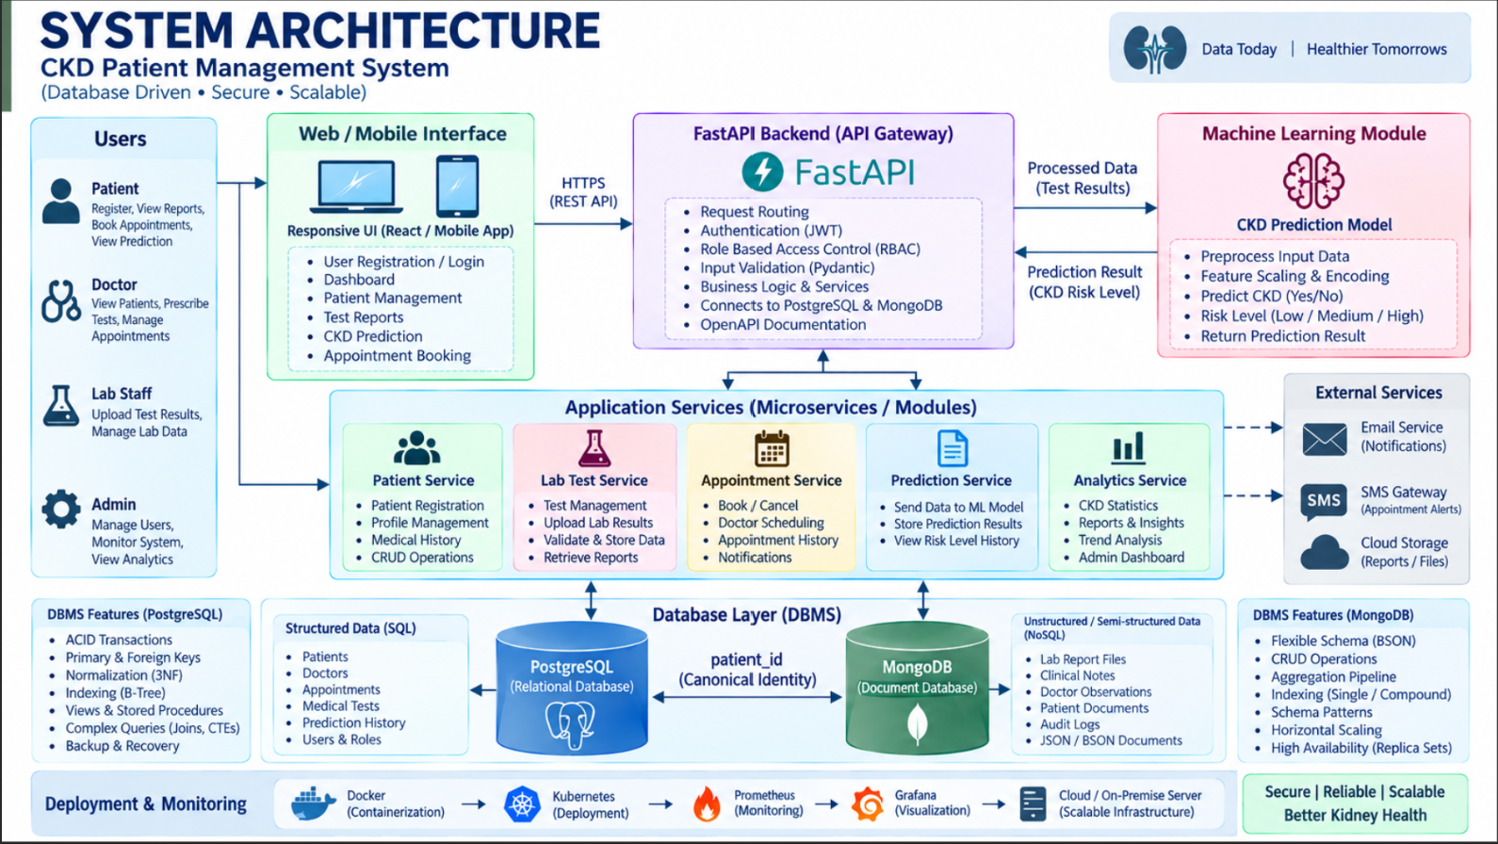
System Architecture
09
LAYERED FLOW
CLIENT
API & SECURITY
SERVICES
DATA
Web / Mobile UI
FastAPI Gateway
Auth + RBAC
Validation
Patient Service
Lab Service
Prediction Service
Appointment Service
DATA STORAGE
PostgreSQL
Patients • Doctors • Tests
Appointments • Predictions
MongoDB
Lab reports • Clinical notes
Flexible observations
patient_id = canonical identity
DEPLOYMENT & MONITORING
Docker
Kubernetes
Prometheus / Grafana
CKD Patient Management System
9

Slide 10
Technologies Used
10
IMPLEMENTATION STACK
Frontend
Backend
Relational DB
HTML / CSS / JavaScript
FastAPI + Python
PostgreSQL
Patient and staff interface
REST APIs and service logic
Structured records and transactions
Document DB
ML / Data
Security
MongoDB
Python + pandas + scikit-learn
JWT / OAuth2 concepts + RBAC
Flexible clinical documents
Preprocessing and CKD classification
Authentication and access control
Testing
Deployment
Monitoring
pytest + API tests
Docker + Kubernetes
Prometheus + Grafana
Functional and security validation
Containerized deployment
Metrics and observability
CKD Patient Management System
10

Slide 11
Dataset / Input Details
11
DATA USED BY THE SYSTEM
Public CKD dataset
Operational input
• UCI Chronic Kidney Disease dataset
• 400 instances and 24 input features
• Classification target: CKD / not-CKD
• Contains missing values that require preprocessing
• Features include age, blood pressure, albumin, glucose, urea, creatinine, electrolytes and blood counts
• Patient profile and demographic details
• Medical test measurements
• Doctor and appointment information
• Prediction request + prediction history
• User role and audit information
Data preparation: raw records → cleaning → missing-value handling → encoding → validation → model-ready input
CKD Patient Management System
11

Slide 12
Implementation – Module 1
12
PATIENT & DATABASE MANAGEMENT
Patient Registration
Validate Input
Store in PostgreSQL
Retrieve / Update
Database engineering
Output
• Patient, doctor, appointment, test and prediction entities
• Primary and foreign keys maintain relationships
• NOT NULL, UNIQUE and CHECK constraints protect data quality
• Indexes support frequent patient and appointment lookups
• Transactions keep related updates consistent
A consistent patient record becomes the central identity used across clinical workflows.
PATIENT ID
RELATIONSHIPS
AUDITABLE
CKD Patient Management System
12

Slide 13
Implementation – Module 2
13
CKD PREDICTION PIPELINE
Clinical Input
Preprocess
Feature Vector
Classifier
CKD Result
Prediction steps
Design principle
• Accept required clinical features from the patient/test record.
• Clean and encode the values using the same preprocessing logic used during training.
• Generate the model input and obtain the predicted CKD class.
• Store the prediction with patient ID and timestamp.
Prediction is a decision-support component—not a replacement for clinical diagnosis.
The system should present the result together with the underlying patient/test context.
CKD Patient Management System
13

Slide 14
Implementation – Module 3
14
APPOINTMENTS, APIS & SECURITY
Client Request
Authenticate
Authorize
Validate
Service + DB
API capabilities
Security controls
• Patient CRUD operations
• Medical test and prediction endpoints
• Appointment creation and retrieval
• Pydantic request validation
• OpenAPI documentation and centralized error handling
• JWT / OAuth2-style authentication
• Role-based access for admin, doctor, staff and patient
• Password hashing
• Rate limiting and audit events
• Secure separation of client, service and database layers
CKD Patient Management System
14

Slide 15
Experimental Setup
15
HOW THE PROTOTYPE IS EVALUATED
Dataset
UCI CKD dataset; 400 records; 24 features
Preprocessing
Missing values, categorical encoding, validation and feature preparation
Split
Train / validation / test separation to avoid leakage
Backend
FastAPI with PostgreSQL + MongoDB integration
Testing
API, validation, authentication and database operation tests
Environment
Python development environment; containerization prepared for deployment
CKD Patient Management System
15

Slide 16
Results
16
PROTOTYPE OUTCOMES
1
Database layer
Patient, doctor, test, appointment and prediction entities mapped to a relational design.
2
Hybrid storage
PostgreSQL handles structured records; MongoDB supports flexible clinical documents.
3
Prediction workflow
Clinical inputs can move through preprocessing to a CKD classification result.
4
API layer
FastAPI provides validated service endpoints and a clear security flow.
5
Workflow integration
Registration → test → prediction → appointment → analytics/reporting is represented as one process.
CKD Patient Management System
16

Slide 17
Performance Evaluation
17
METRICS TO VALIDATE
Accuracy
Precision
Recall
F1-score
Correct CKD classifications / total predictions
Reliability of positive CKD predictions
Ability to identify CKD cases
Balance of precision and recall
AUC
API latency
DB latency
Throughput
Discrimination across classification thresholds
Time required for secure request processing
Time for key patient / appointment queries
Requests handled during load testing
Important: the current project material does not provide measured accuracy, latency or throughput values; these should be filled after final experiments.
CKD Patient Management System
17

Slide 18
Screenshots / Working Demo
18
PROTOTYPE WORKFLOW
PATIENT DASHBOARD
CKD PREDICTION
WORKING FLOW
Patient profile
INPUT
PREPROCESS
MODEL
Register
Lab test entry
Clinical features
Record test
CKD prediction
Predict
CKD RESULT
Book appointment
Appointment
View report
Prototype screen structure
Use actual implementation screenshots here when available.
CKD Patient Management System
18

Slide 19
Comparison with Existing System
19
WHY THE PROPOSED SYSTEM IS STRONGER
Capability
Manual / isolated system
Proposed CKD system
Patient records
Separate files / repeated entry
Centralized PostgreSQL records
Clinical documents
Fixed or scattered storage
MongoDB supports flexible documents
CKD prediction
Separate analysis step
Integrated prediction workflow
Appointments
Independent scheduling
Linked to patient and doctor records
Access control
Basic / inconsistent
Authentication + RBAC
Scalability
Limited
API + container-ready architecture
Monitoring
Minimal
Prometheus / Grafana ready
CKD Patient Management System
19

Slide 20
Challenges & Solutions
19
IMPLEMENTATION CONSIDERATIONS
Missing values
Use documented imputation and validation before prediction.
→ Cleaner model input
Mixed data types
Normalize categorical and numeric representations.
→ Consistent features
Dual databases
Use patient_id as the canonical identity.
→ Reliable linkage
Sensitive data
RBAC, authentication, hashing and audit logging.
→ Controlled access
Model reliability
Use held-out evaluation and external validation later.
→ Safer deployment
Scaling
Separate services and containerize components.
→ Deployment readiness
CKD Patient Management System
19

Slide 21
Future Work
21
NEXT DEVELOPMENT STEPS
Roadmap
01
Use larger and more diverse clinical datasets.
02
Add stage-specific CKD risk prediction and longitudinal patient history.
03
Add explainable AI so clinicians can understand important features behind a prediction.
04
Perform external validation and prospective clinical evaluation before real-world use.
05
Strengthen privacy with encryption, key management and detailed audit trails.
06
Deploy services with Kubernetes, CI/CD and production monitoring.
07
Add patient notifications, doctor dashboards and analytics.
CKD Patient Management System
21

Slide 22
Conclusion
22
PROJECT SUMMARY
A unified CKD healthcare platform
The project combines database engineering, CKD prediction and secure backend development into one connected workflow.
Reliable data
Flexible records
Prediction
Secure APIs
PostgreSQL + constraints + transactions
MongoDB + common patient identity
Clinical input → CKD classification
FastAPI + validation + RBAC
FINAL FLOW
Dataset → Clean & Validate → PostgreSQL / MongoDB → FastAPI → CKD Prediction → Secure APIs → Deployment & Monitoring
CKD Patient Management System
22

Slide 23
References
23
KEY SOURCES
References used for project framing
1. UCI Machine Learning Repository, “Chronic Kidney Disease” dataset, Dataset 336.
2. KDIGO, “2024 Clinical Practice Guideline for the Evaluation and Management of Chronic Kidney Disease,” Kidney International, 2024.
3. Capodici et al., “Predict, diagnose, and treat chronic kidney disease with machine learning: a systematic literature review,” Journal of Nephrology, 2023. DOI: 10.1007/s40620-023-01573-4.
4. Khalid et al., “Predicting the Progression of Chronic Kidney Disease: A Systematic Review of Artificial Intelligence and Machine Learning Approaches,” Cureus, 2024. DOI: 10.7759/cureus.60145.
5. Pan & Tong, “Artificial intelligence in predicting chronic kidney disease prognosis: A systematic review and meta-analysis,” Renal Failure, 2024. DOI: 10.1080/0886022X.2024.2435483.
6. Gogoi et al., “Machine learning approaches for predicting and diagnosing chronic kidney disease: current trends, challenges, solutions, and future directions,” 2024.
CKD Patient Management System
23

